Slide 1
Counting
Part 3 – Permutation and Combination

Slide 2
Graph -1

Slide 3
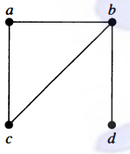

Graph
A graph $G=(V,E)$ consists of $V$, a nonempty set of vertices (or nodes), and $E$, a set of edges.

Slide 4
Different Types of Graph
Undirected Graph
Simple graph
Multi graph
Pseudo graph
Directed Graph
Simple directed graph
Directed multigraph
Mixed Graph

Slide 5
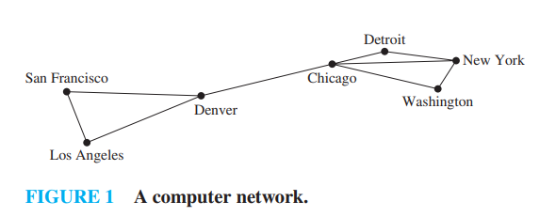
Undirected Graph
Definition : The edges of the graph do not have any direction.

Slide 6
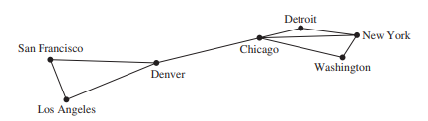
Undirected Graph
Simple Graph :
Each edge connects two different vertices
No two edges connect the same pair of vertices is called a simple graph.

Slide 7
Undirected Graph
Multi Graph
Graphs that may have multiple edges connecting the same vertices are called multigraphs
No Edge connects the same pair
When there are m different edges associated to the same unordered pair of vertices {u, v}, we also say that {u, v} is an edge of multiplicity m.

Slide 8
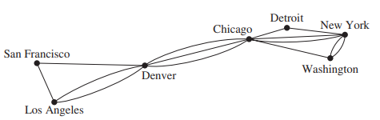
Undirected Graph
Multi Graph
Graphs that may have multiple edges connecting the same vertices are called multigraphs
No Edge connects the same pair
When there are m different edges associated to the same unordered pair of vertices {u, v}, we also say that {u, v} is an edge of multiplicity m.

Slide 9
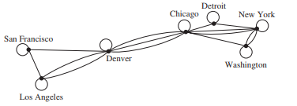
Undirected Graph
Pseudo graph
Graphs that may include loops (edge connecting a vertex to itself)
And may have multiple edges connecting the same pair of vertices or a vertex to itself

Slide 10
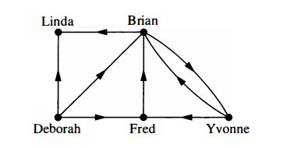
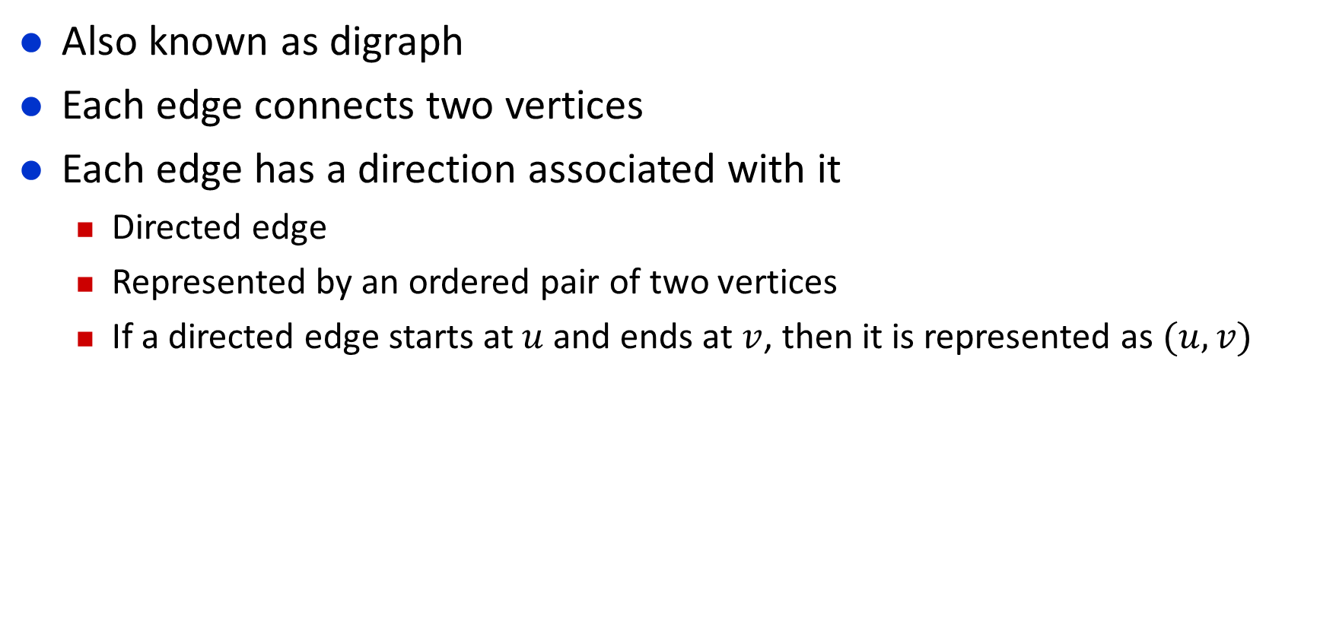
Directed Graph
Also known as digraph
Each edge connects two vertices
Each edge has a direction associated with it
Directed edge
Represented by an ordered pair of two vertices
If a directed edge starts at $u$ and ends at $v$, then it is represented as $(u,v)$

Slide 11
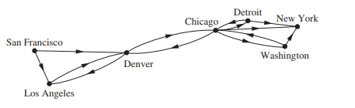
Directed Graph
Definition : The edges of the graph have direction

Slide 12
Directed Graph
Simple Directed Graph
A directed graph that has
no loops
no multiple directed edges,

Slide 13
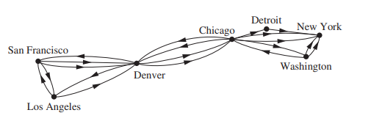
Directed Graph
Directed multigraphs
Directed graphs that may have multiple directed edges from a vertex to a second (possibly the same) vertex are used to model such networks.
We called such graphs directed multigraphs.

Slide 14
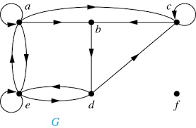
Directed Graph
Directed multigraphs

Slide 15
Mixed Graph
A graph which consists of both:
Directed edges
Undirected edges

Slide 16
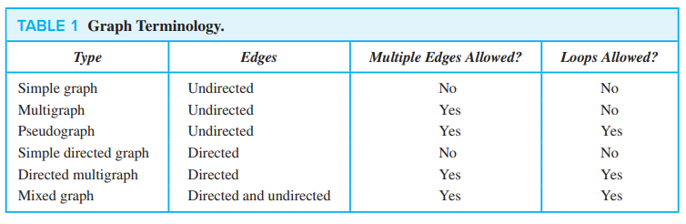
Graph Terminologies

Slide 17
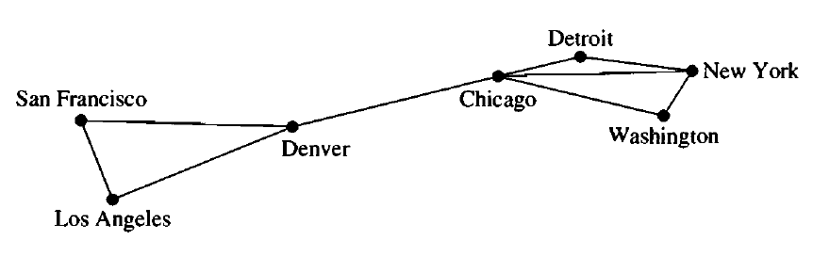
Weighted Graph
Each edge has a weight
Here, weight means data transmission rate between the vertices
9
1
7
3
5
2
8
2
4

Slide 18
Exercise
Graph Denoting Acquaintanceship
A graph that represents whether two people know each other or not
What sort of graph is it?

Slide 19
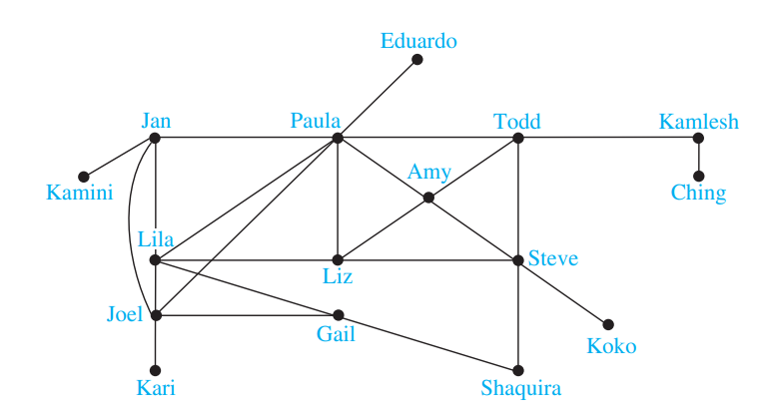
Exercise
Graph Denoting Acquaintanceship
Simple undirected
graph

Slide 20
Exercise
Graphs Denoting Hollywood Collaboration
A graph that represents whether two actors have worked together in a movie
What sort of graph is it?

Slide 21
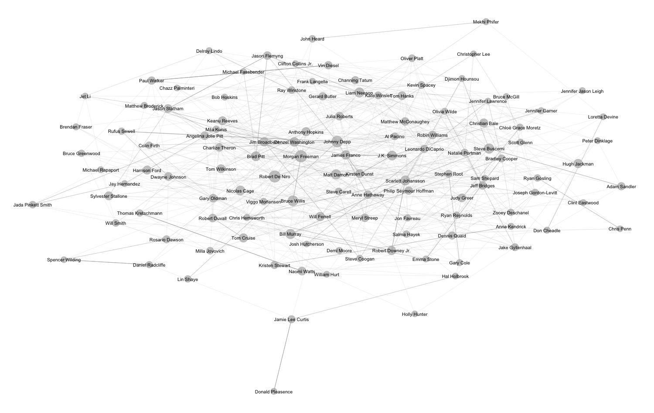
Exercise
Graphs Denoting Hollywood Collaboration
Simple undirected
graph

Slide 22
Exercise
Graph Denoting Tournament Game Plays
Each team plays with the other teams exactly once
We create a graph to represent the match results
What sort of graph is it?

Slide 23
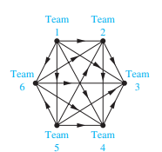
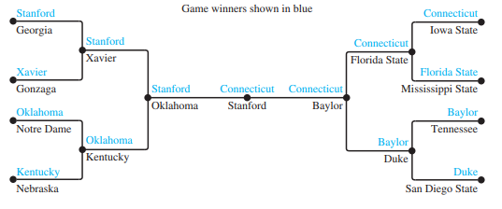
Exercise
Graph Denoting Tournament Game Plays

Slide 24
Exercise
Graph Denoting Tournament Game Plays
Simple directed graph
Simple undirected graph

Slide 25
Exercise
Graph denoting phone calls
Graph that shows the phone calls made from one number to another
What sort of graph is it?

Slide 26
Exercise
Graph denoting phone calls
Graph that shows the phone calls made from one number to another
What sort of graph is it?
Directed Multi Graph

Slide 27
Thank You

